Slide 1


Titolo presentazione sottotitolo
Blind Source Separation with Negentropy-based Independent Component Analysis
Milano, XX mese 20XX
Gabriele Carrino, Nicolò Pisanu

Slide 2
Introduction
Aims:
Implement the FastIca algorithm
Validate it with custom dataset
Sources:
Independent component analysis: An introduction. (Alaa Tharwat)
Blind Source Separation of Underwater Acoustic Signal by Use of Negentropy-based Fast ICA Algorithm. (Tu Shijie and Chen Hang)

Slide 3
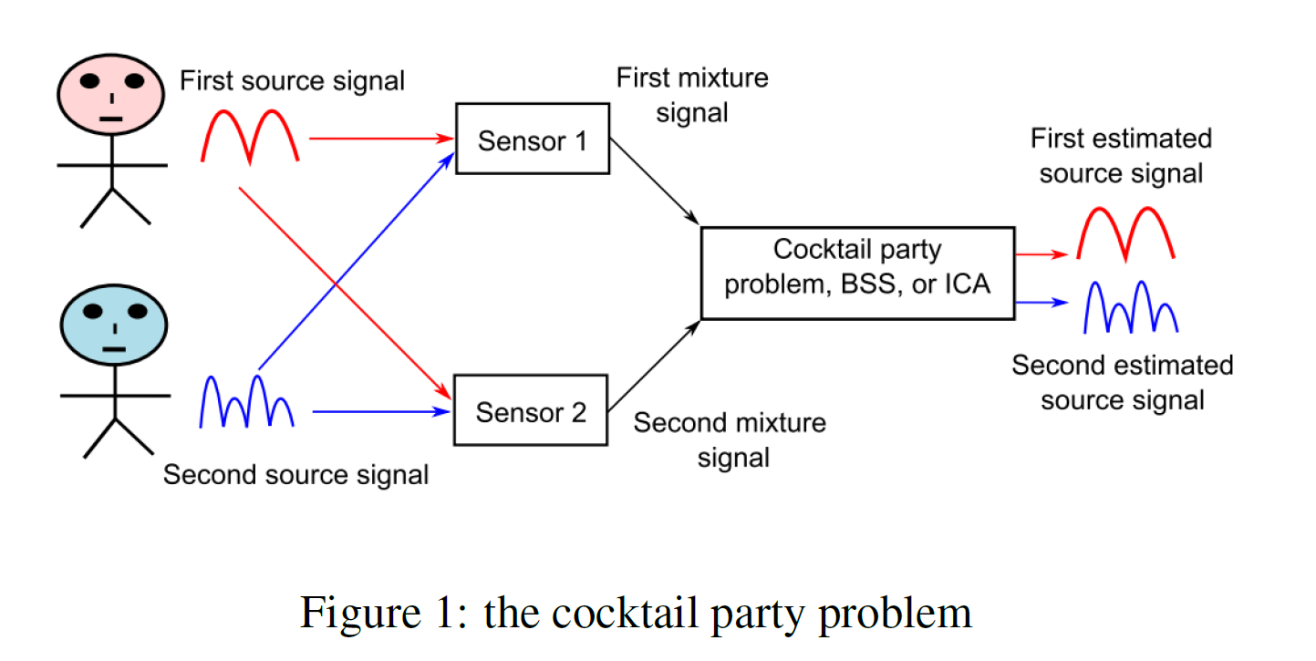
Theoretical background: Blind Source Separation
Blind source separation (BSS) refers to the concept of recovering hidden source signals from mixed observations, without any prior knowledge of the mixing process or the original source signals themselves.

Slide 4
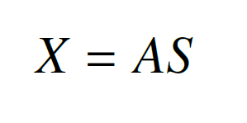
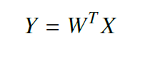
Mathematical formalism
The notation used in this paper follows the one in the work by Alaa Tharwat
We define a mixture of signals as:
Our aim, by applying ICA, it to find the unmixing matrix W:
A: mixing matrix
S: original signals
X: mixtures.
W: unmixing matrix
Y: recovered signals
X: mixtures.

Slide 5
Assumptions behind the algorithm
Idea:
inversion of the central limit theorem (CLT)
Two assumptions on the source signals:
Non-Gaussian:
gaussian noise + gaussian noise = gaussian noise
We can’t discern the original noises!
Independent:
If the independent assumption does not hold we can’t reverse the CTL!

Slide 6
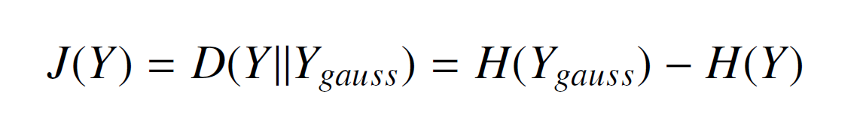
Neg-entropy maximization
To be able to do what we described above we need to find a suitable metric for independence and non-gaussianity to maximize, a possible one for the non-gaussianity is neg-entropy.
We define neg-entropy as the kullback-leibler divergence of a random variable Y from a gaussian distribution with the same mean and variance:

Slide 7
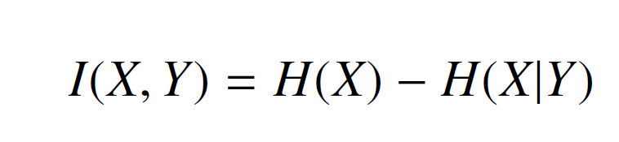
Mutual Information
In information theory, mutual information quantifies the shared information between two random variables, X and Y. It measures the reduction in uncertainty about X after observing Y (and vice versa).
Higher mutual information indicates a stronger dependence between the variable, while lower / zero values indicate independence.
Formally we define mutual information as:

Slide 8
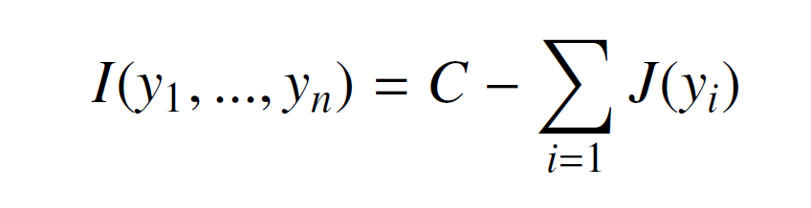
Mutual information minimization
An interesting fact is that by maximizing neg-entropy we aren’t only searching for the most non-gaussian signals, but also for the most independent among them as we are effectively minimizing mutual information.
This can be proven by the fact that mutual information can be rewritten by neg-entropy in this way:
Where C is a constant term

Slide 9
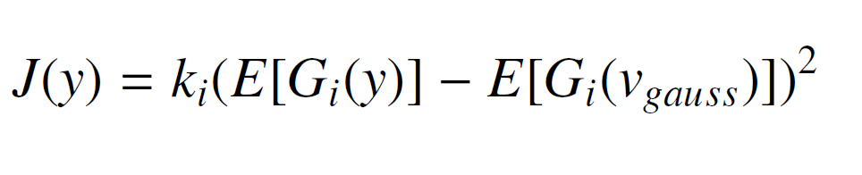
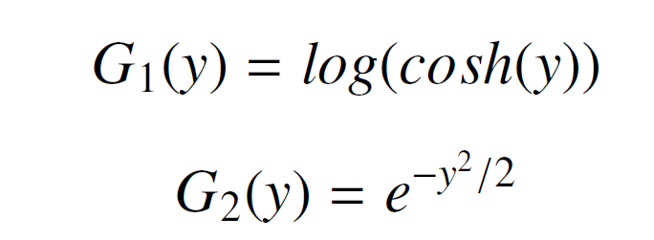
The need for approximations
Calculating the entropy for finite data can be problematic, for this reason we use an approximation of neg-entropy given by:
Where Gi is a non-quadratic function such as:
ki: a constant
v ∼ N(0,1)
X: mixtures.

Slide 10
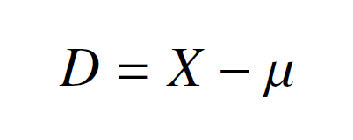
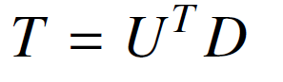
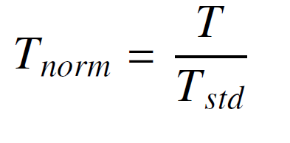
Preprocessing
Before being able to feed our data to the ICA algorithm we need to apply a centering and a whitening step.
Those steps are really important as they help in decorrelating the data and making the independent components easier to detect.
Centering:
Whitening:
Decorrelation:
Normalization:
(PCA)

Slide 11
Undercomplete ICA
Undercomplete ICA refers to the case when we have more mixture than sources.
To tackle this case, when we perform decorrelation, we keep only the first components up to the number of sources.
This helps in lowering the dimensionality of the problem and makes the algorithm work more efficiently.

Slide 12
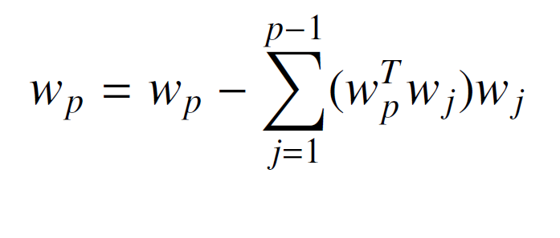
Multiple component extraction
The classical ICA algorithm estimates only one component.
To estimate more than one we need to perform the Gram-Schmidt orthogonalization for every previously obtained component:

Slide 13
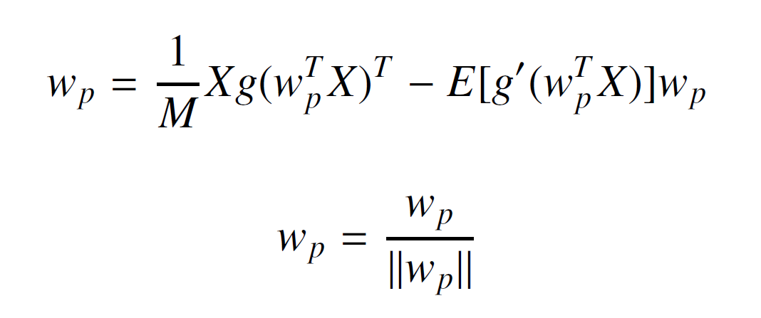
Update rule
Derived by maximizing the neg-entropy J(Y) for the extracted signals using a fixed-point iteration scheme.
Two steps:

Slide 14
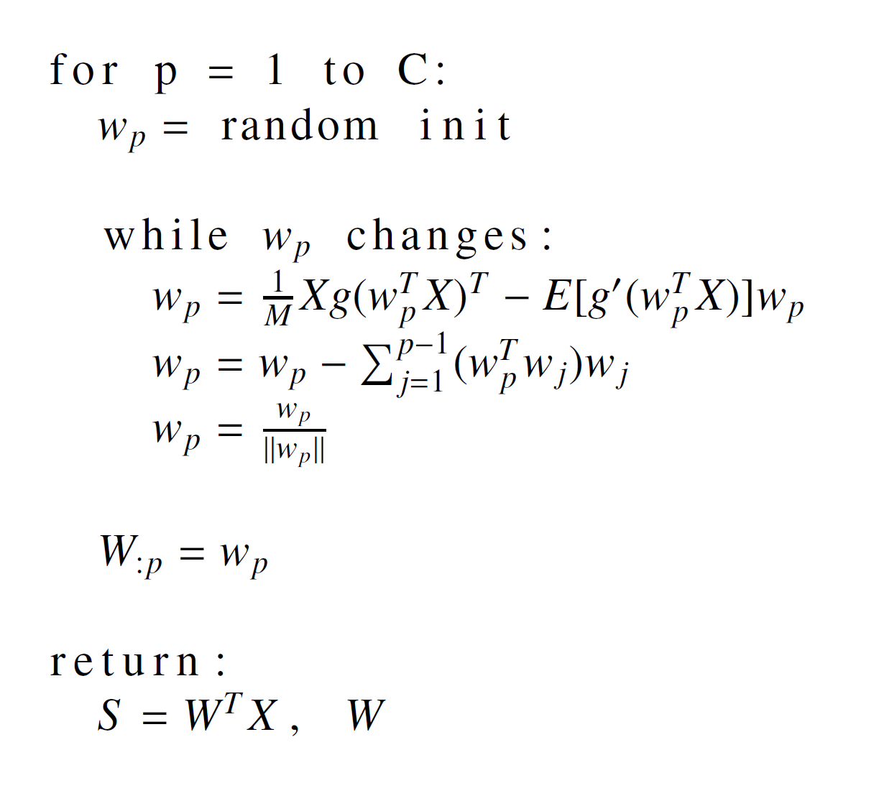
Complete Algorithm
Input: C number of desired components, X preprocessed data.
Output: S extracted independent components, W unmixing matrix.

Slide 15
Ambiguities of ICA
ICA has some inherent ambiguities:
Order of Independent Components: The order in which the components are extracted is arbitrary. This is because the weight vector wp is initialized randomly and iteratively updated to find one independent component. Thus, ICA extracts source signals without a specific order.
Sign of Independent Components: The sign of the extracted components does not affect their independence, as such the matrix W in n-dimensional space has 2-n local minima , i.e., two local maxima for each independent component, corresponding to si and -si.

Slide 16
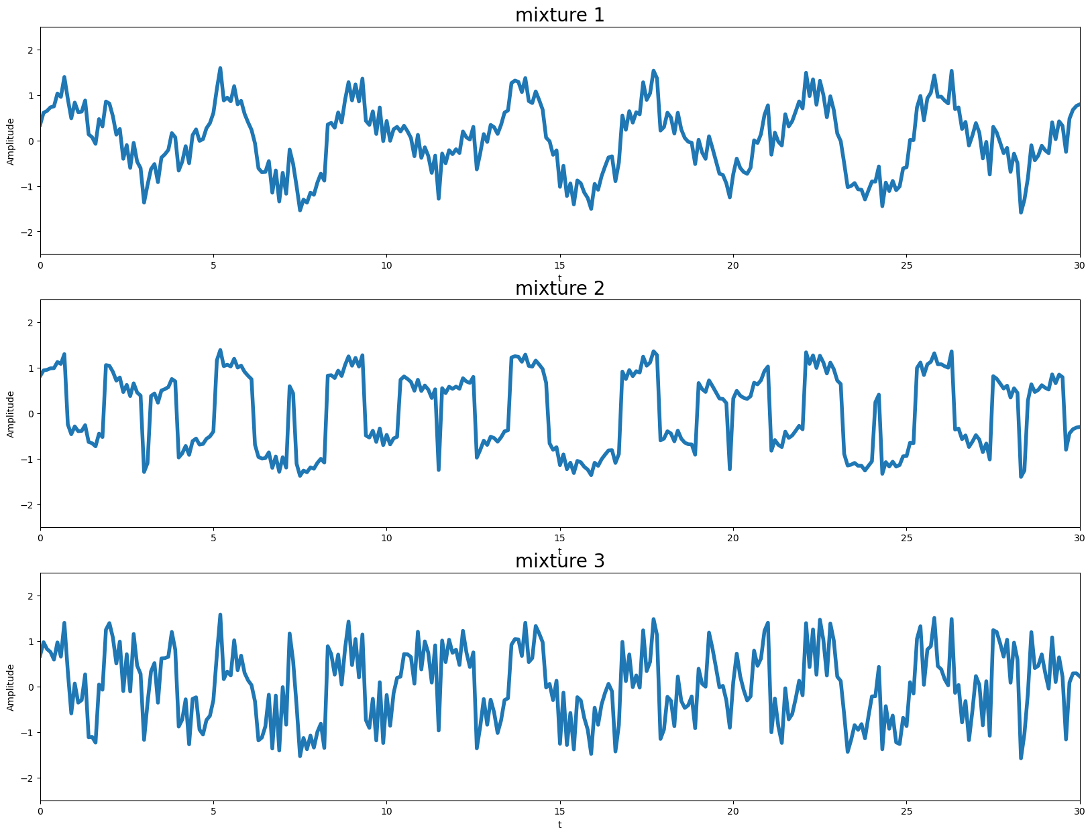
Example 1
3 sources
3 mixtures

Slide 17
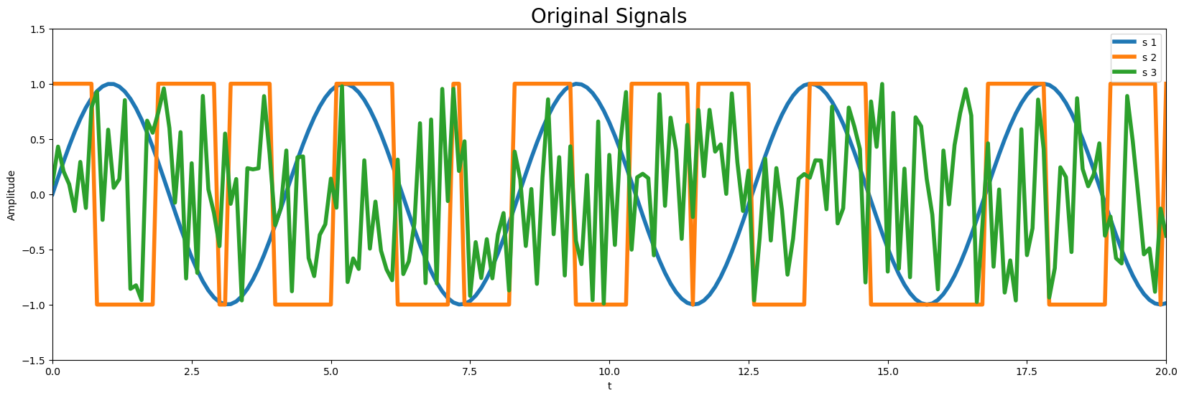
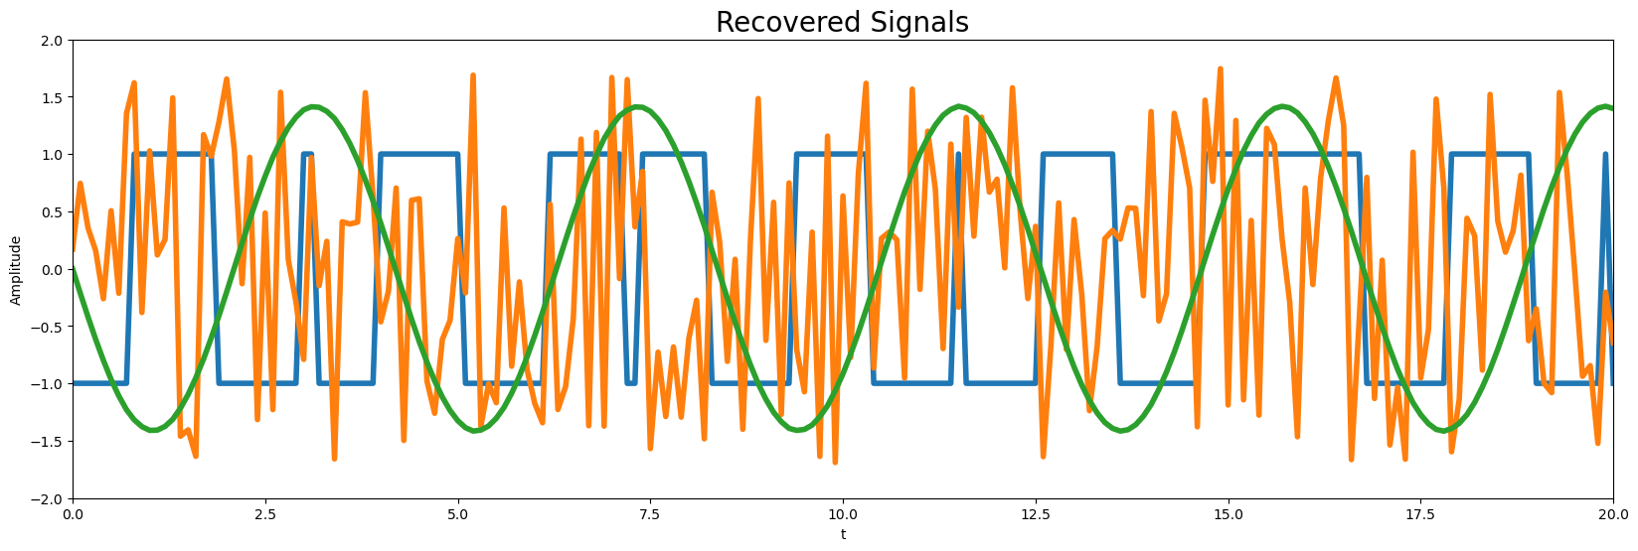
Results

Slide 18
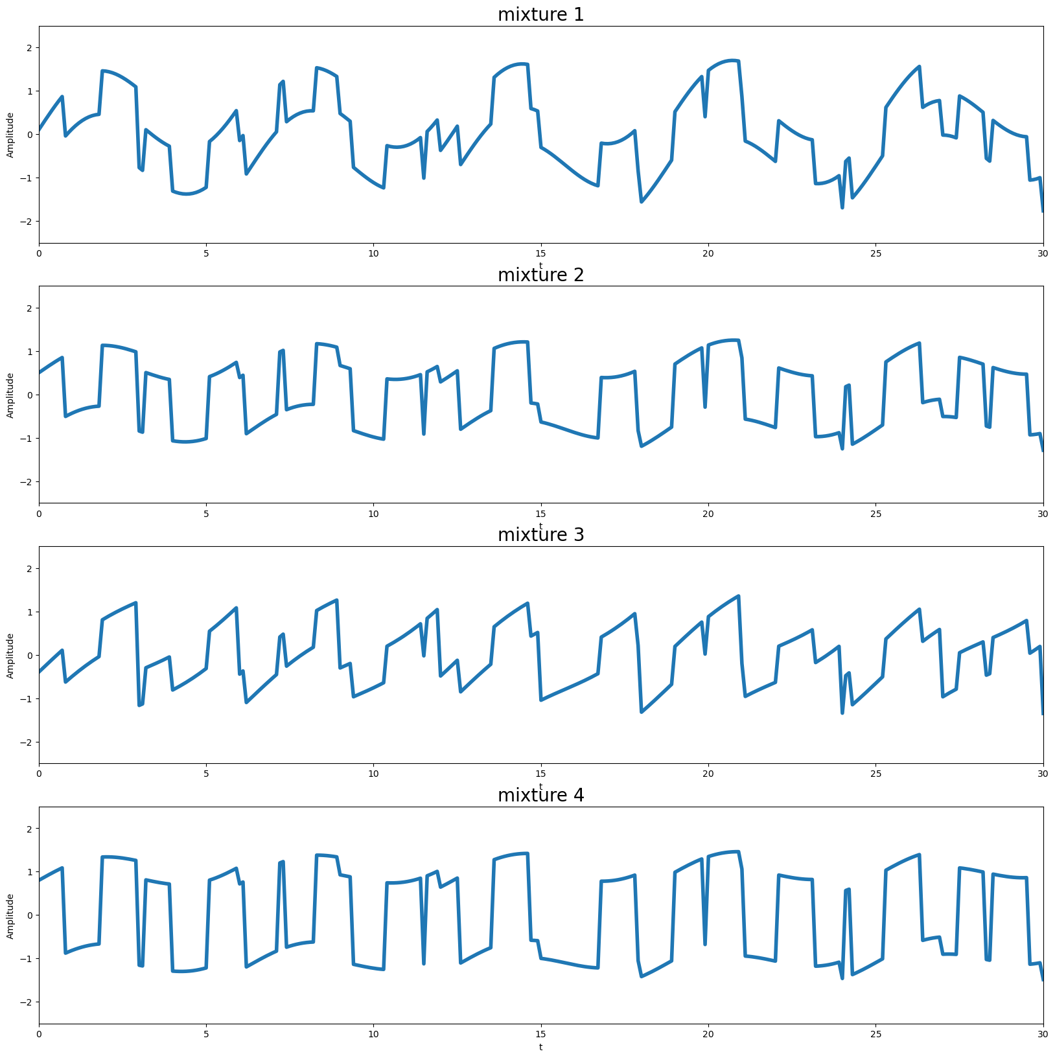
Example 2: Undercomplete ICA
4 mixtures
3 sources

Slide 19
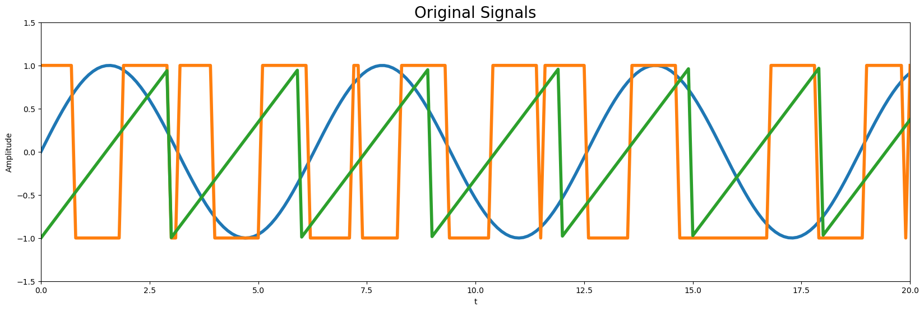
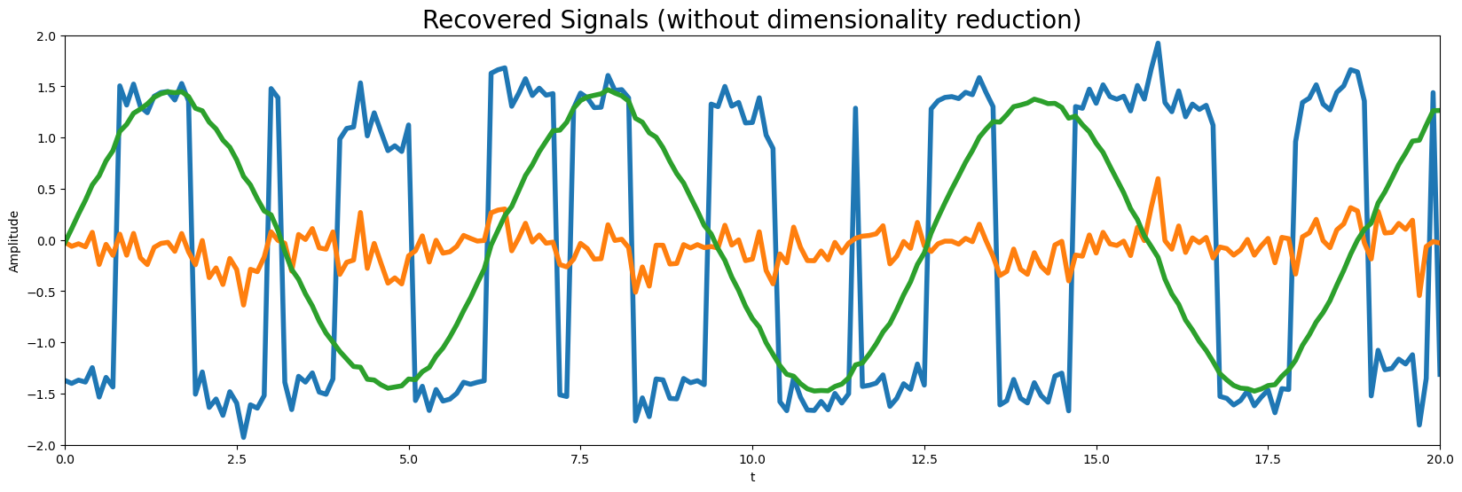
Results: No Dimensionality Reduction

Slide 20
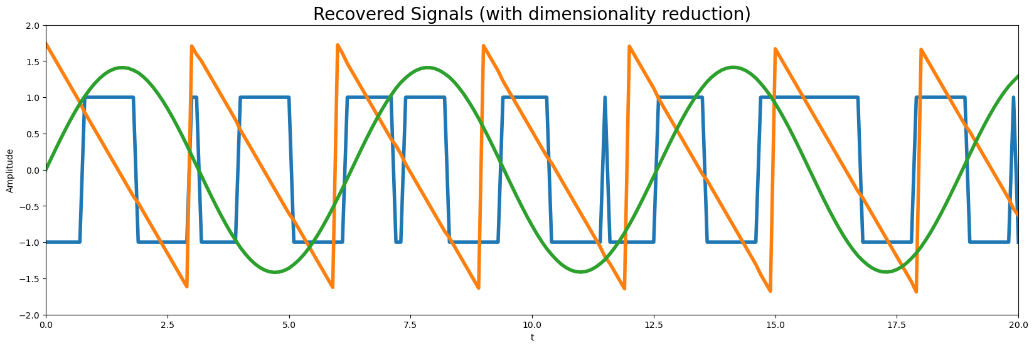
Results: Dimensionality Reduction

Slide 21
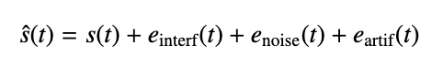
Validation (1)
Performance is based on the principle that a reconstructed source can be decomposed as:
s(t) is the original source
e_{interf}(t) is the noise due to interference with other sources
e_{noise}(t) is a perturbation term due to noise
e_{artif}(t) is the noise due to artifacts created by the separation process

Slide 22
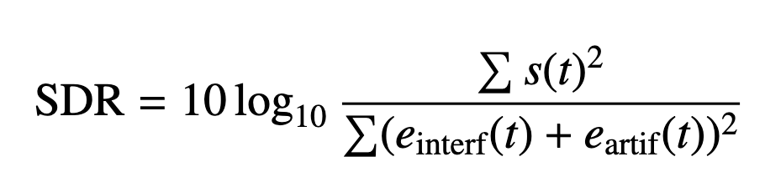
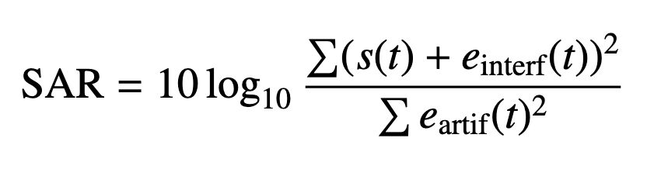
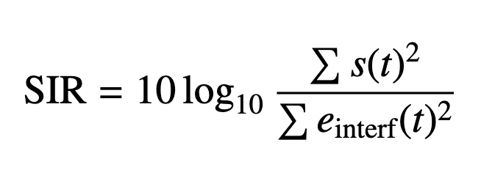
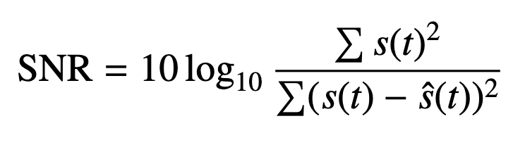
Validation (2)
Source-to-Distortion Ratio (SDR):
original source signal to the total distortion present in the estimated source
Source-to-Artifact Ratio (SAR):
original source signal to the amount of artifacts present in the estimated source
Source-to-Interference Ratio (SIR):
how well the separation process has isolated the target source from interfering sources
Source-to-Noise Ratio (SNR):
measures the total amount of noise relative to the original source signal defined by difference

Slide 23
Experimental Scenarios
Four distinct scenarios:
Ideal cocktail-party
Real cocktail-party
Jazz-club Jam
Rush-hour
Features:
Spaces with unique acoustics characteristics
Heterogeneous auditory landscapes
Different ratio of N sources and M microphones

Slide 24
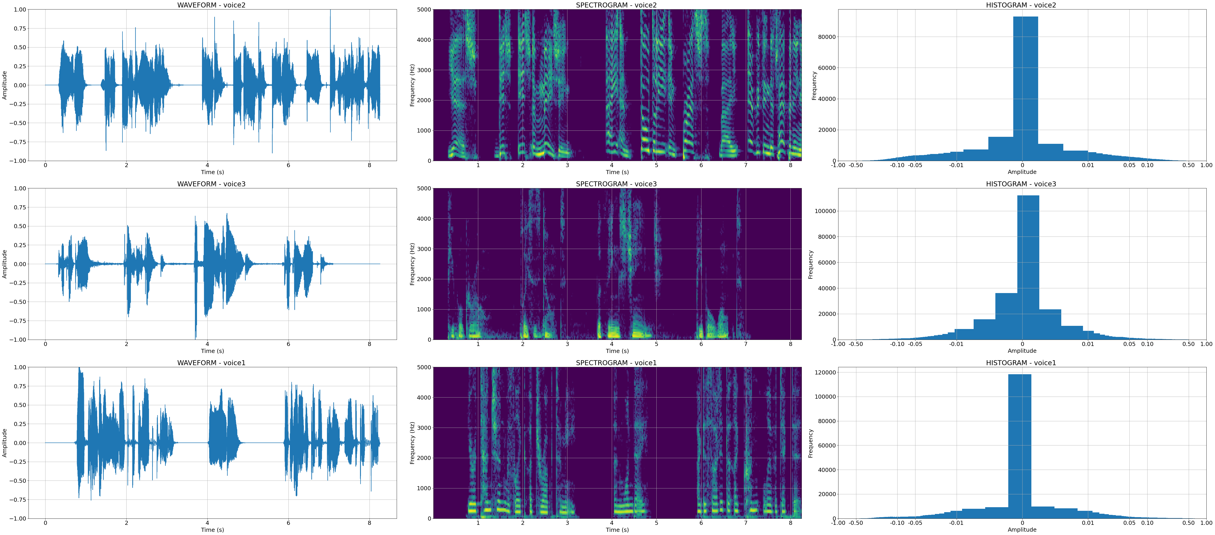


Scenario 1: Ideal cocktail-party (1)
N=3 human-voice sources​
M=3 mixtures
Custom mixing-matrix (only amplitude affected)
one mix (of 3):

Slide 25
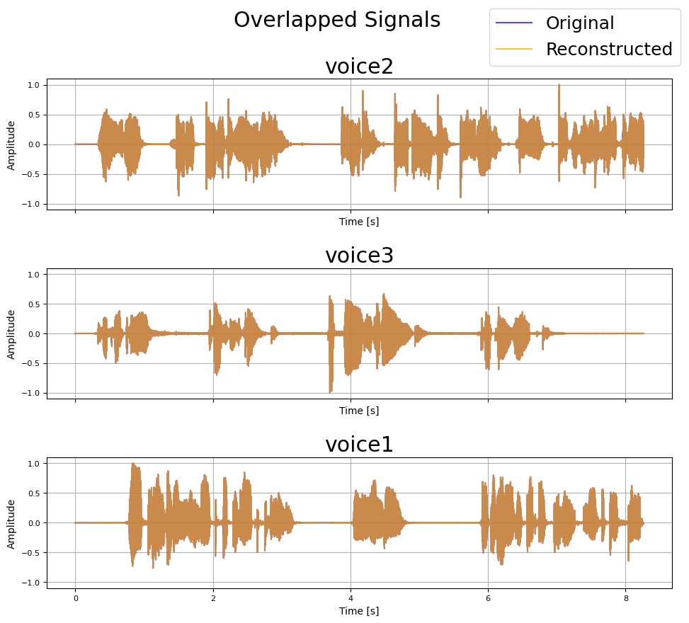
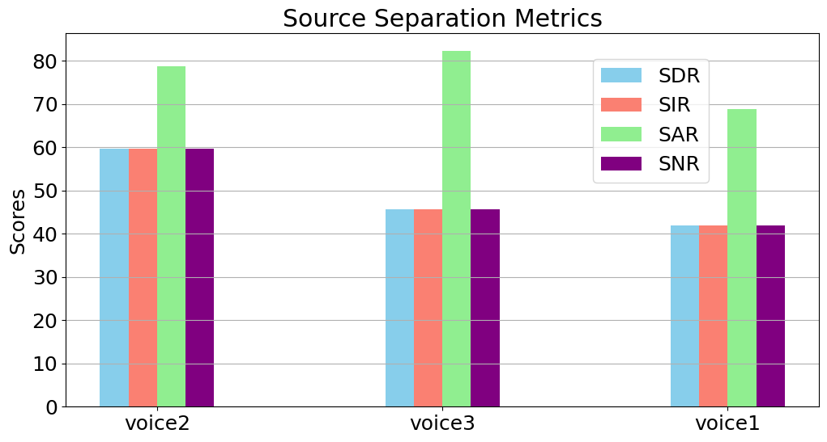
Scenario 1: Ideal cocktail-party (2)
Sources are perfectly reconstructed!

Slide 26
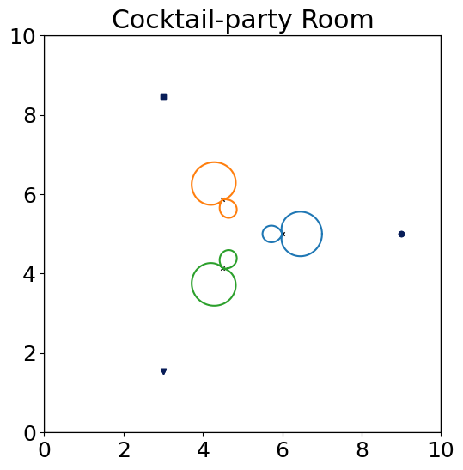
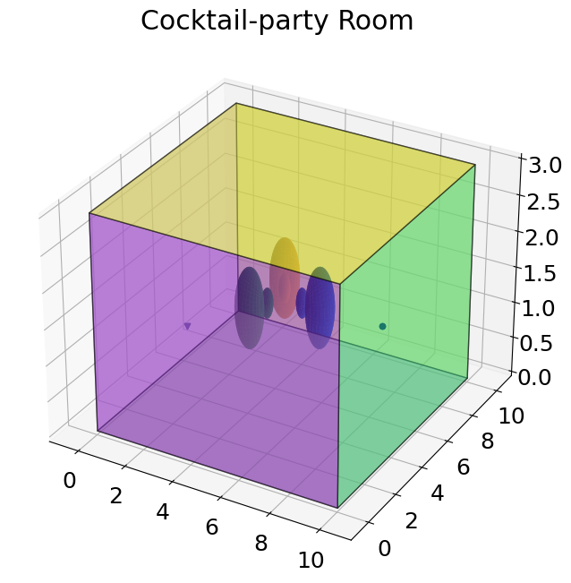
Scenario 2: Real cocktail-party (1)
N=3 human-voice sources (same as before)
M=3 hyper-cardioid microphones
highly-absorbent room
one mix (of 3):

Slide 27
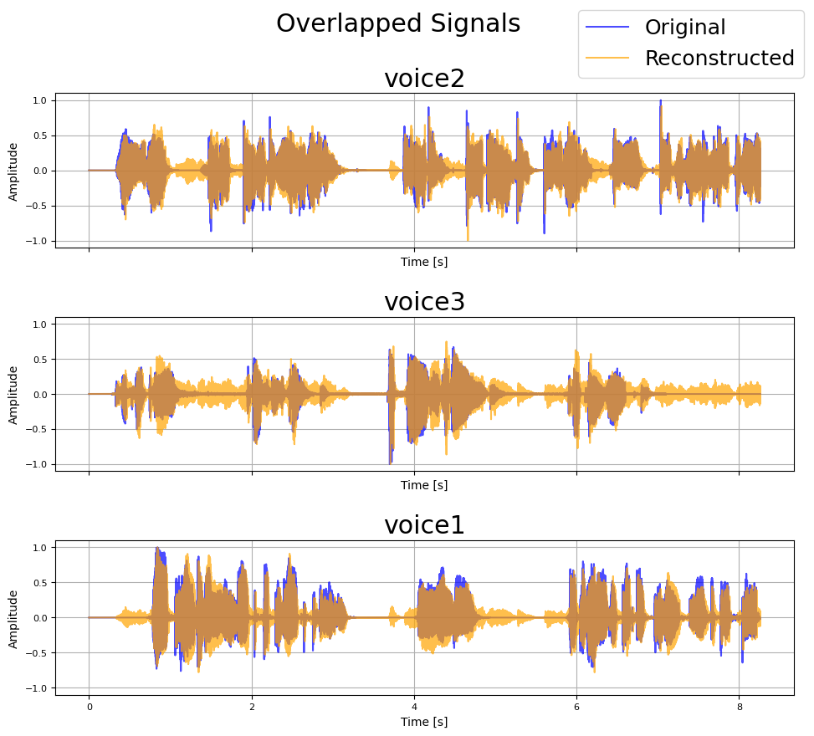
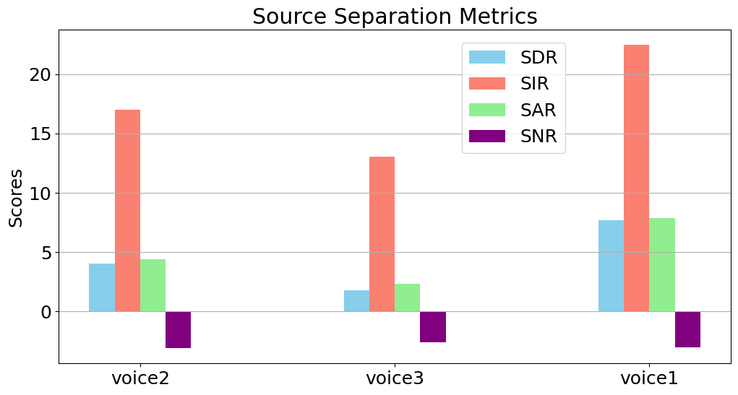
Scenario 2: Real cocktail-party (2)
The results are very good and come close to the ideal case, but do not quite reach it.

Slide 28
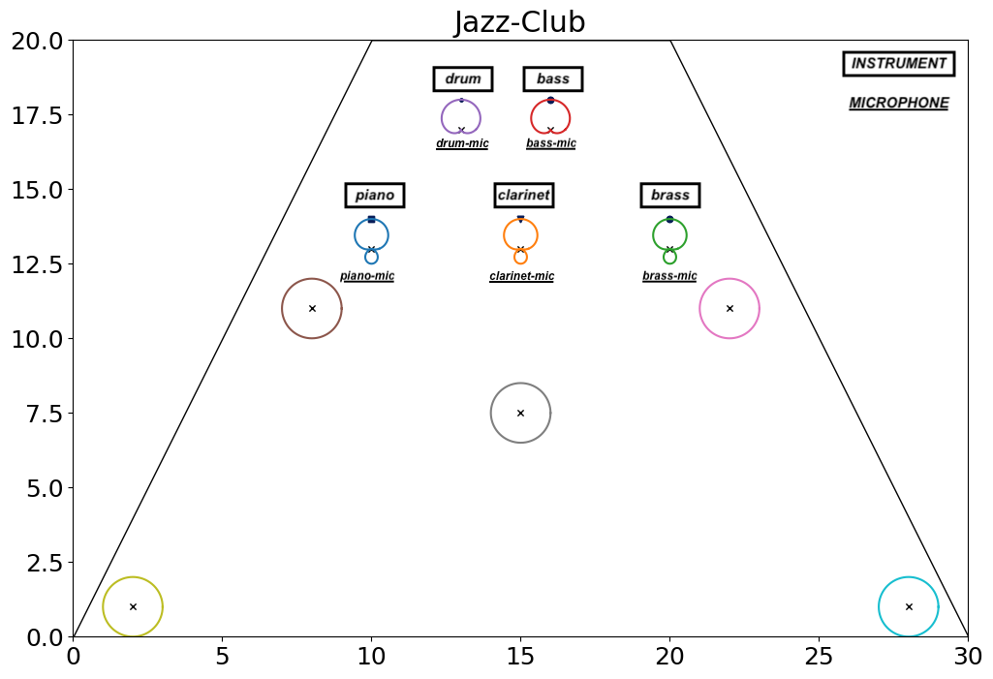
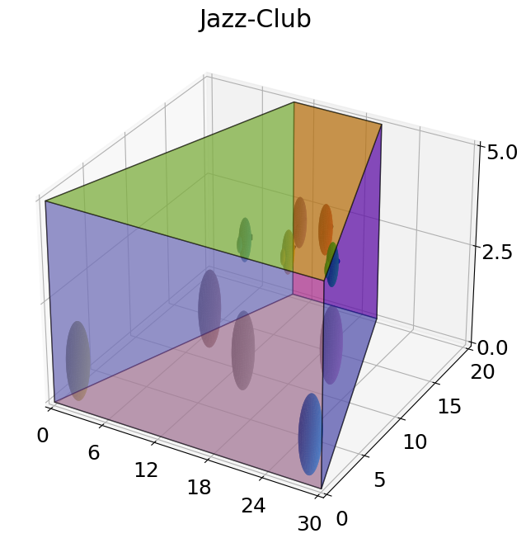
Scenario 3: Jazz-club jam (1)
N = 5 musical instrument sources
M = 10 microphones with various polar patterns
Room with low sound absorption
Unique architectural shape
Some instruments:
Some mix:

Slide 29
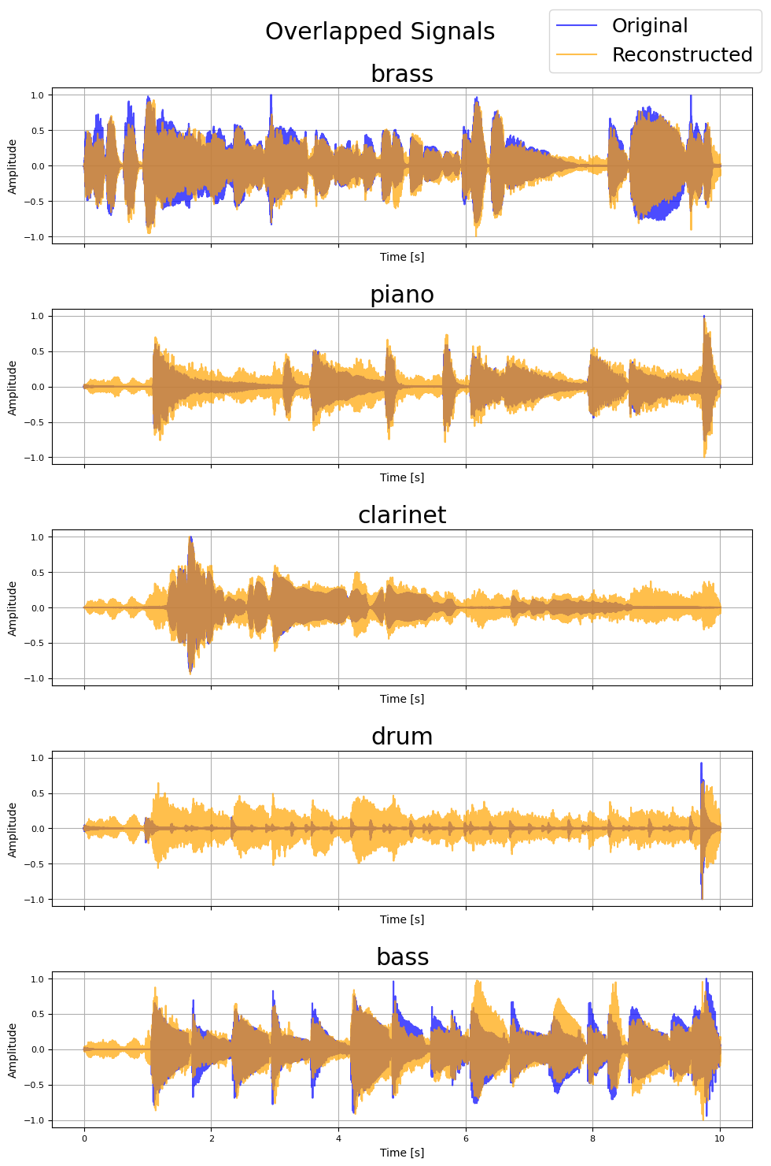
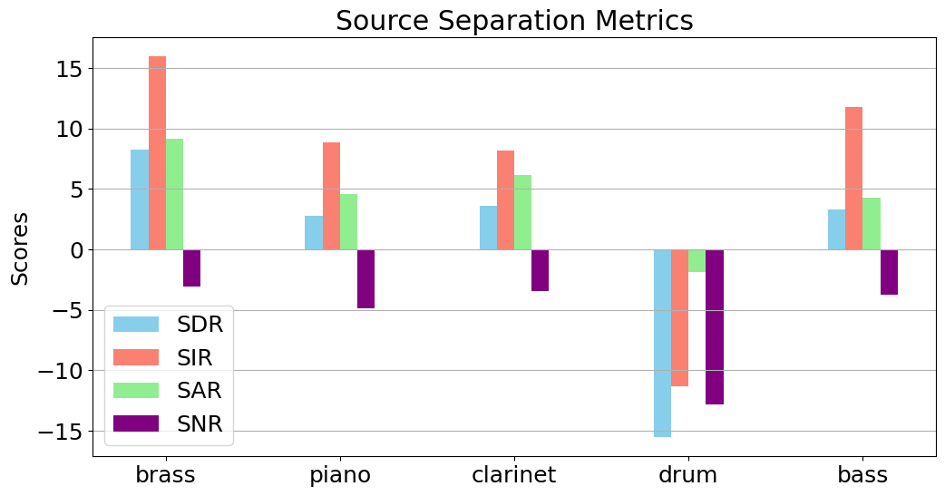
Scenario 3: Jazz-club jam (2)
Results vary depending on the sources' nature.

Slide 30
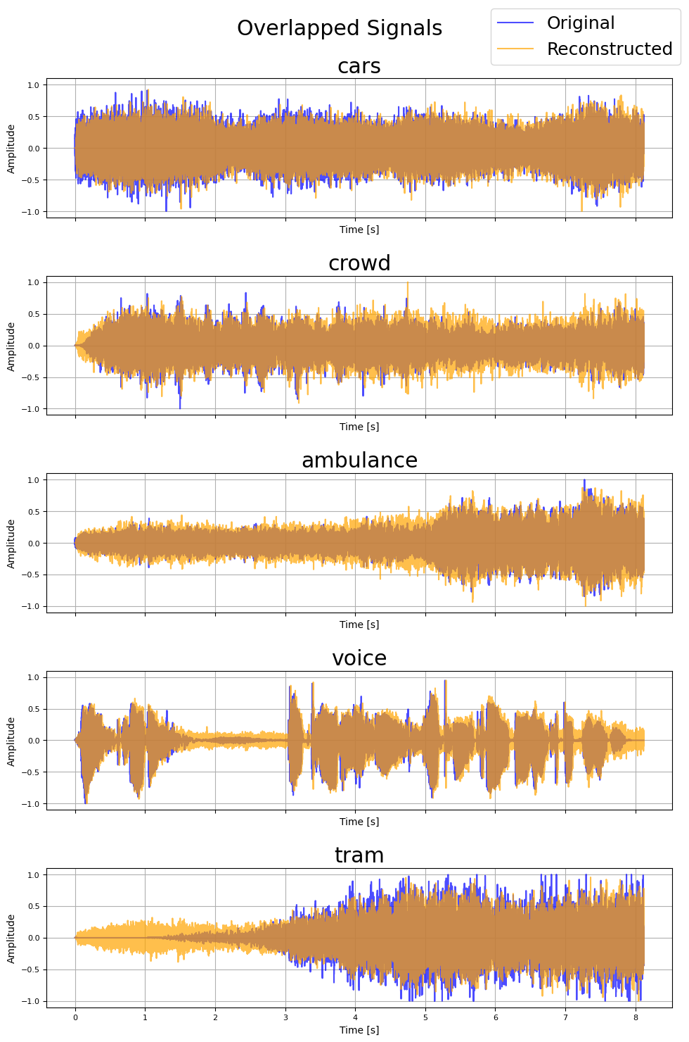
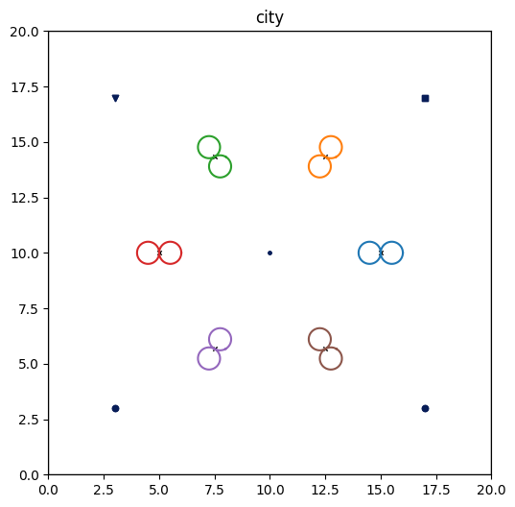
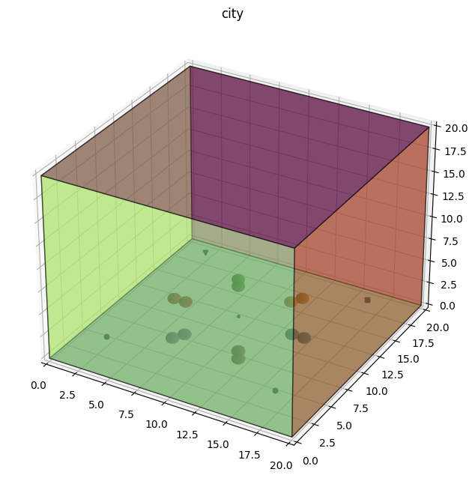
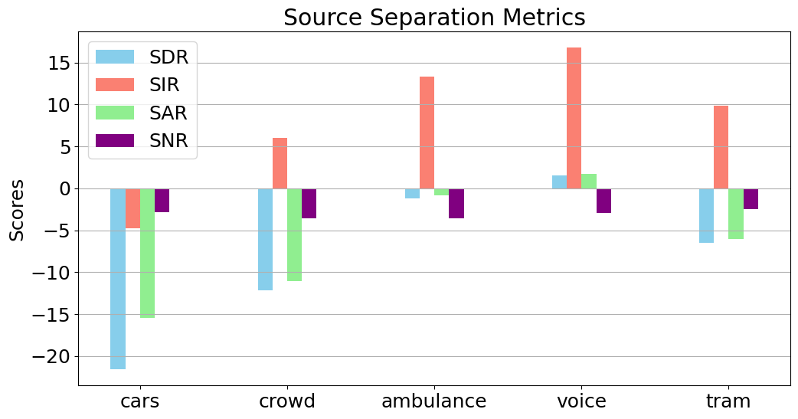
Scenario 4: Rush-hour
N=4 noisy sources + N=1 voice source
M=6 eight-shape microphones​
high-absorbent enviroment
original: mixed: reconstructed:

Slide 31
Conclusion
Effectiveness of FastICA: Excellent for separating sources with distinctive statistical properties.
Robustness: Consistent results across different scenarios.
Real-World Limitations: Challenges in real acoustic environments due to alterations in amplitude, phase, and spectral content.
Key Issues: Signal delays in microphones reduce FastICA's effectiveness.
Potential Improvements: Incorporate information about positions of sources and microphones to enhance performance.
Evaluation Metrics: SIR as the primary indicator of separation quality; SNR inadequate.
Source Assignment: Addressed using highest SIR and observing extreme values for phase inversion issues.

